Slide 1

GREEN PUBLIC TRANSPORT NETWORK
TEAM MEMBERS:
GOKKULNATH.S(2023PECCS754)
GOWTHAM.V(2023PECCS760)
CO-ORDINATORS:DR.P.DEEPA,MRS.S.LINCY JEMINA
GUIDE NAME:MRS.LINCY JEMINA

Slide 2
ABSTRACT
The transition to electric buses presents opportunities for sustainable public transport but also challenges in charging time, infrastructure, and operational costs. This project addresses these issues by developing an optimized system for charging management, battery swapping, and smart scheduling. The approach reduces vehicle downtime, improves energy utilization, and enhances fleet performance. By focusing on cost efficiency and environmental benefits, the study provides a practical model to support the wider adoption of electric buses in urban transportation systems.

Slide 3
INTRODUCTION
Electric buses are a key step toward sustainable and eco-friendly public transportation.
They help reduce greenhouse gas emissions, lower fuel costs, and improve urban air quality.
Despite their benefits, challenges include limited driving range, long charging times, and high infrastructure costs.
This project focuses on optimizing charging operations, introducing battery swapping, and improving scheduling techniques.
The approach aims to reduce downtime, enhance energy efficiency, and improve fleet reliability.
By addressing these challenges, the project supports the transition to cleaner, more efficient public transport networks.

Slide 4
LITERATURE REVIEW
S.No | Title | Authors | Year | Description
1 | Enhancing public transportation sustainability: Insights from electric bus scheduling and charge optimization | Foroogh Behnia | 2025 | The paper presents a joint optimization model for electric bus scheduling and charging, using partial charging and speed variations. A Windsor case study shows 2.5% cost savings and 7% efficiency gains, proving that smart charging improves sustainable public transport.
2 | Optimal Design of Charging Infrastructure and Battery Sizing for Electric Bus based Public Transportation System | Amita kumari | 2023 | This paper focuses on determining the optimal design of charging infrastructure and battery capacity for electric bus fleets in public transportation. It aims to minimize operational costs and energy consumption while ensuring efficient route coverage and reliable service.
3 | Optimizing energy-efficient grid performance: integrating electric vehicles, DSTATCOM, and renewable sources using the Hippopotamus Optimization Algorithm | A.A.Ali | 2024 | This paper presents a strategy to optimize energy-efficient grid performance by integrating electric vehicles, DSTATCOM devices, and renewable energy sources. It leverages the Hippopotamus Optimization Algorithm to enhance voltage stability, reduce power losses, and improve overall grid reliability.
4 | MILP-Based Charging and Route Selection of Electric Vehicles in Smart Grid | Anoop Yadav | 2021 | This paper explores the use of Mixed-Integer Linear Programming (MILP) for optimizing electric vehicle charging and route selection within a smart grid. The approach aims to minimize energy costs, reduce grid congestion, and improve overall efficiency of EV operations.
5 | The Electric Vehicle Scheduling Problem for Buses in Networks with Multi-Port Charging Stations | Matina L.Y. Chau | 2024 | This paper addresses the scheduling of electric buses in networks equipped with multi-port charging stations. It focuses on optimizing bus routes and charging times to minimize operational delays, energy costs, and ensure efficient fleet utilization.
6 | Adaptive energy management strategy for sustainable xEV charging stations in hybrid microgrid architecture | Saleha Tabassum | 2025 | This paper proposes an adaptive energy management strategy for sustainable charging of electric and hybrid vehicles (xEVs) within a hybrid microgrid. It aims to optimize energy allocation from renewable and conventional sources, reduce costs, and enhance the reliability and efficiency of the charging stations.

Slide 5
S.No | Title | Authors | Year | Description
8 | Optimizing sustainable urban mobility: A comprehensive review of electric bus scheduling strategies and future directions | Mitra Mirhassani | 2024 | This paper provides a comprehensive review of electric bus scheduling strategies for sustainable urban mobility. It analyzes current optimization methods, highlights challenges in energy efficiency and operational planning, and outlines future research directions for improving electric bus networks.
9 | Optimal Electric Bus Charging Scheduling with Multiple Vehicle and Charger Types Considering Compatibility | Venkata Ramana Naidu Darbha | 2023 | This paper proposes optimal electric bus charging schedules considering multiple bus and charger types to minimize costs and maximize efficiency.
10 | Battery electric buses charging schedule optimization considering time-of-use electricity price | Tao Wang | 2022 | This paper focuses on optimizing electric bus charging schedules by considering time-of-use electricity prices to reduce energy costs and improve operational efficiency.
11 | Optimizing Electric Bus Charging Scheduling with Uncertainties Using Hierarchical Deep Reinforcement Learning | K Ramesha | 2023 | This paper presents a hierarchical deep reinforcement learning approach to optimize electric bus charging schedules under uncertainty, enhancing efficiency and cost-effectiveness.
12 | Multi-factor optimization for electric bus charging stations: Integrating electrical, social, and environmental perspectives | M.Vijayalakshmi | 2023 | This paper explores multi-factor optimization of electric bus charging stations by integrating electrical, social, and environmental considerations to achieve sustainable and efficient operations.
13 | Ev charging management in a real-time optimization framework considering operational constraints | Vishal Bhardwaj | 2021 | This paper presents a real-time optimization framework for EV charging management that accounts for operational constraints to improve efficiency and reliability.
14 | Electric Bus Charging Scheduling for a Bus Depot | Satish Gajare | 2023 | This paper addresses the scheduling of electric bus charging at a depot to minimize energy costs and ensure efficient fleet operation.
15 | Minimum-Delay Opportunity Charging Scheduling for Electric Buses | R.Saravanakumar | 2023 | This paper proposes a minimum-delay scheduling strategy for opportunity charging of electric buses to reduce downtime and improve service efficiency.

Slide 6
EXISTING SYSTEMS
1.Fixed-Schedule Charging
EV buses are charged based on predefined schedules (e.g., overnight charging at depots).
Charging slots are assigned without considering real-time bus utilization, state of charge, or grid conditions.
Can lead to underutilization of chargers during off-peak and overloading during peak demand.
2.Manual Charging Management
Operators or depot managers decide when and which buses to charge.
Often based on experience, shift timings, or route schedules rather than real-time data.
Useful in small fleets but becomes inefficient for large-scale public transport systems.
3.First-Come, First-Served (FCFS) Charging
Buses are charged in the order they arrive at the charging station.
Simple to implement but ignores urgency (e.g., buses scheduled for immediate trips vs. those idle for hours).
May lead to delays and missed schedules.
4.Static Load-Based Charging
Some systems distribute charging based on maximum grid capacity limits.
Ensures the power grid is not overloaded, but lacks dynamic adjustment for renewable availability or sudden demand changes.

Slide 7
Disadvantages Of Existing System
1.Fixed-Schedule Charging
Ignores real-time bus requirements and state of charge.
Can cause unnecessary idle charging or energy wastage.
Leads to peak-load stress on the grid if too many buses charge simultaneously.
2.Manual Charging Management
Depends heavily on human judgment, prone to errors and delays.
Not scalable for large fleets with multiple routes and depots.
Cannot respond quickly to unexpected events like delays, breakdowns, or emergency trips.
3.First-Come, First-Served (FCFS) Charging
Fails to prioritize urgent or high-demand buses.
Causes inefficient utilization of chargers and longer waiting times.
Increases the risk of buses missing scheduled routes due to insufficient charging.
4.Static Load-Based Charging
Focuses only on limiting grid overload, without optimizing cost or renewable integration.
Misses opportunities to use surplus renewable energy during off-peak times.
Does not adapt to sudden fluctuations in demand or traffic conditions.

Slide 8
PROPOSED SYSTEM
1.Charging Optimization
Mostly fixed-time or overnight charging at depots.
Limited grid or tariff consideration.
No fleet-wide real-time optimization.
2.Battery Swapping
First-come-first-served swapping method.
Requires large spare battery stock.
Not standardized across bus models.
3.Bus Scheduling & Routing
Static timetables and fixed routes.
Manual rescheduling during delays.
Minimal use of real-time traffic or charging data.
4.Emergency Handling
Managed manually by operators.
No automated rerouting or backup bus allocation.
Slow response to accidents, breakdowns, or demand surges.

Slide 9
Proposed System-Advantages
Cost Efficiency: Reduces electricity costs by smart charging and avoiding peak-hour tariffs.
Extended Battery Life: Optimized charging and usage cycles prevent premature battery degradation.
Reliable Service: AI-driven scheduling ensures buses run on time and routes are energy-efficient.
Emergency Preparedness: Automated rerouting and backup buses improve response during breakdowns or accidents.
Sustainability: Integrates renewable energy and reduces overall emissions.
Scalability: Can efficiently manage large fleets across multiple depots.

Slide 10
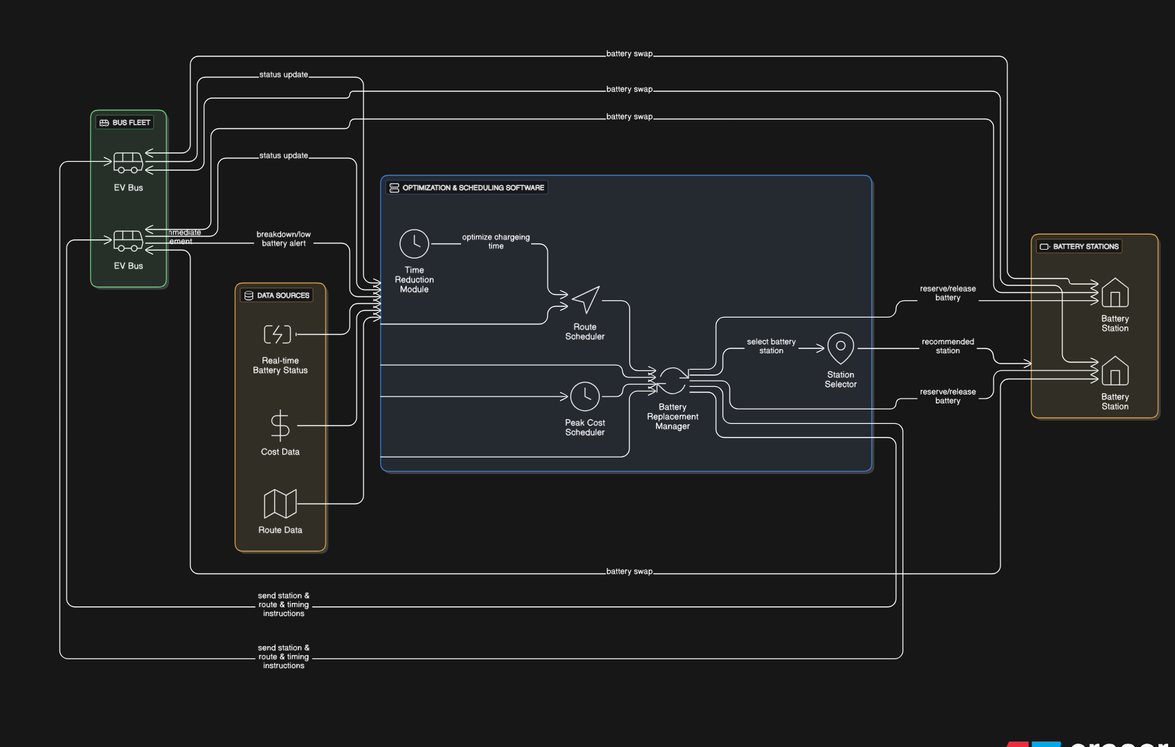
SYSTEM ARCHITECTURE

Slide 11
PROPOSED METHODOLOGY
1.Data Collection
2.Charging Optimization
3.Battery Swapping Management
4.Dynamic Scheduling & Routing
5.Emergency Handling
6.Monitoring & Feedback

Slide 12
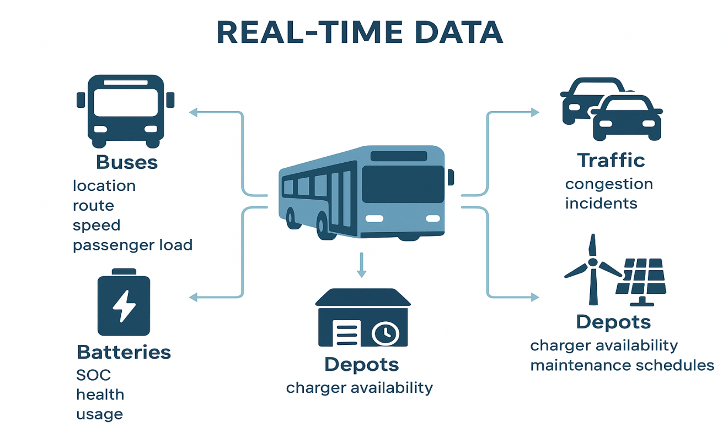
Data Collection
The system gathers critical real-time data from buses (location, route, speed, passenger load), battery parameters (SOC, health, usage), traffic conditions (congestion, incidents), and energy sources (tariffs, renewable supply, grid status). Depot metrics like charger availability and maintenance schedules are also tracked to support efficient charging, scheduling, and emergency response.

Slide 13
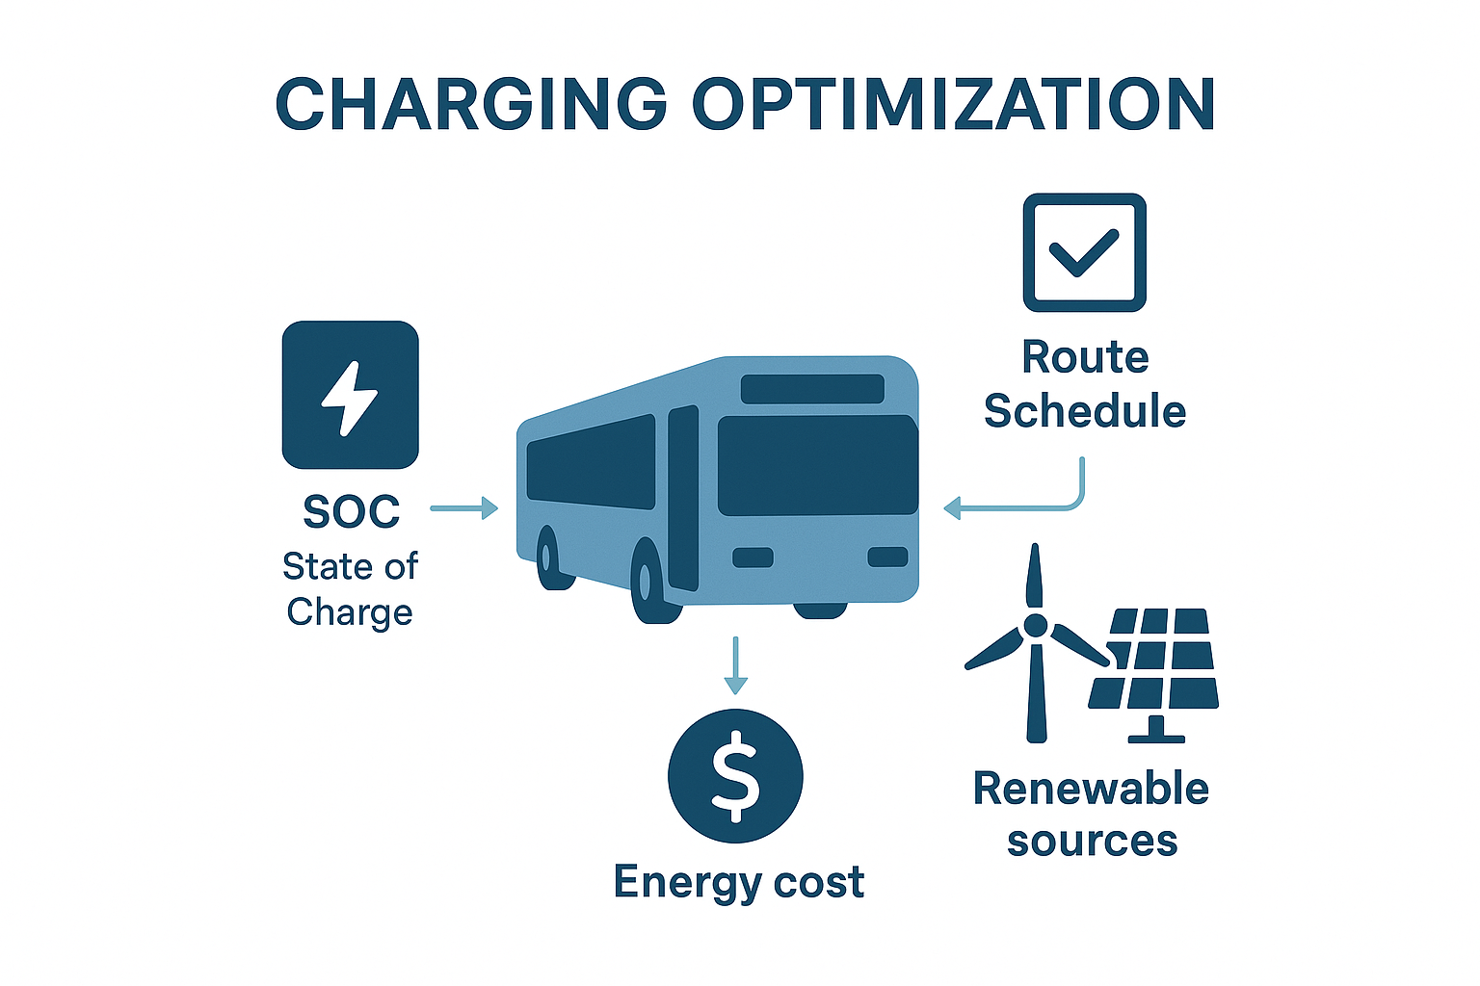
Charging Optimization
The proposed system performs charging optimization by allocating charging slots based on each bus’s State of Charge (SOC), route schedule, and energy cost. It integrates renewable energy sources whenever available and manages depot loads to prevent grid overload, ensuring efficient, cost-effective, and sustainable charging for the entire fleet.

Slide 14
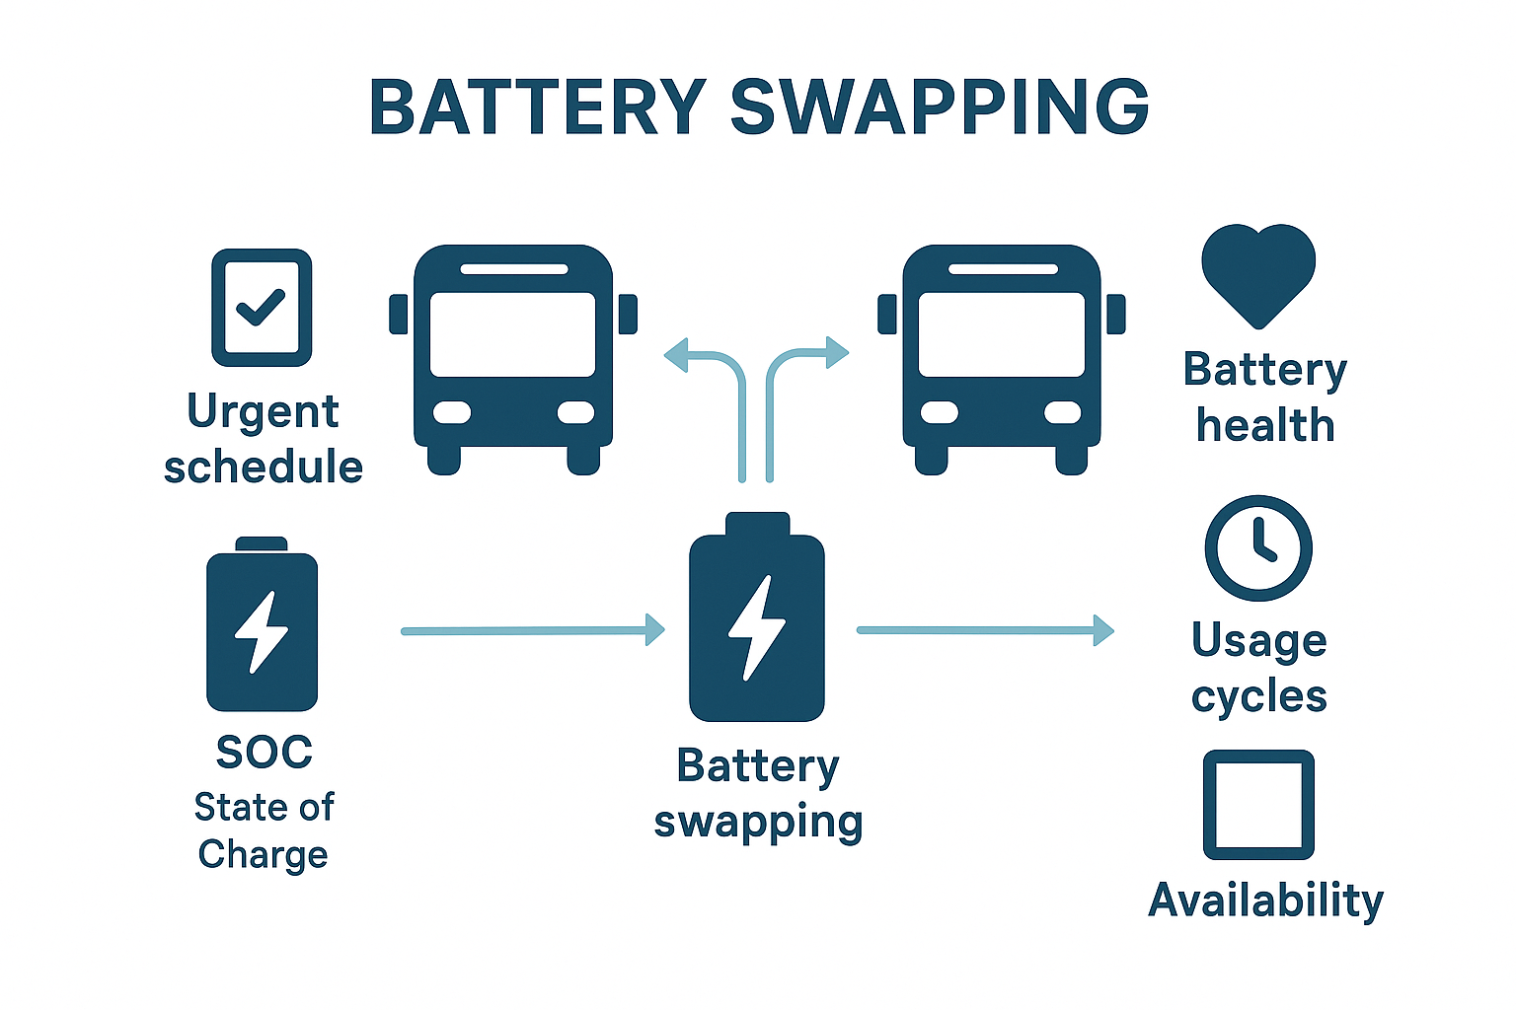
Battery Swapping Management
The system manages battery swapping by prioritizing buses with urgent schedules and low State of Charge (SOC). It monitors battery health, usage cycles, and availability, optimizing the inventory to reduce downtime and ensure efficient fleet operations.

Slide 15
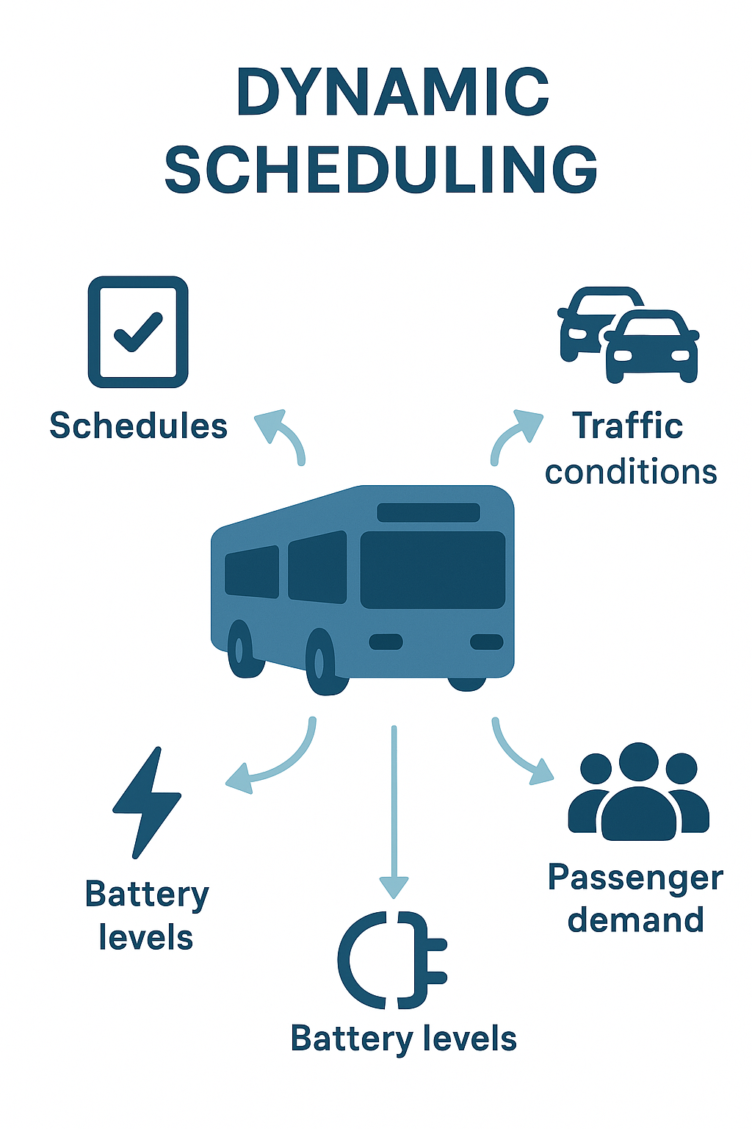
Dynamic Scheduling And Routing
The system uses AI-driven algorithms for dynamic scheduling and routing, adapting timetables and routes based on real-time traffic, passenger demand, and battery levels. It optimizes routes for energy efficiency, minimizes delays, and ensures reliable bus service across the fleet

Slide 16
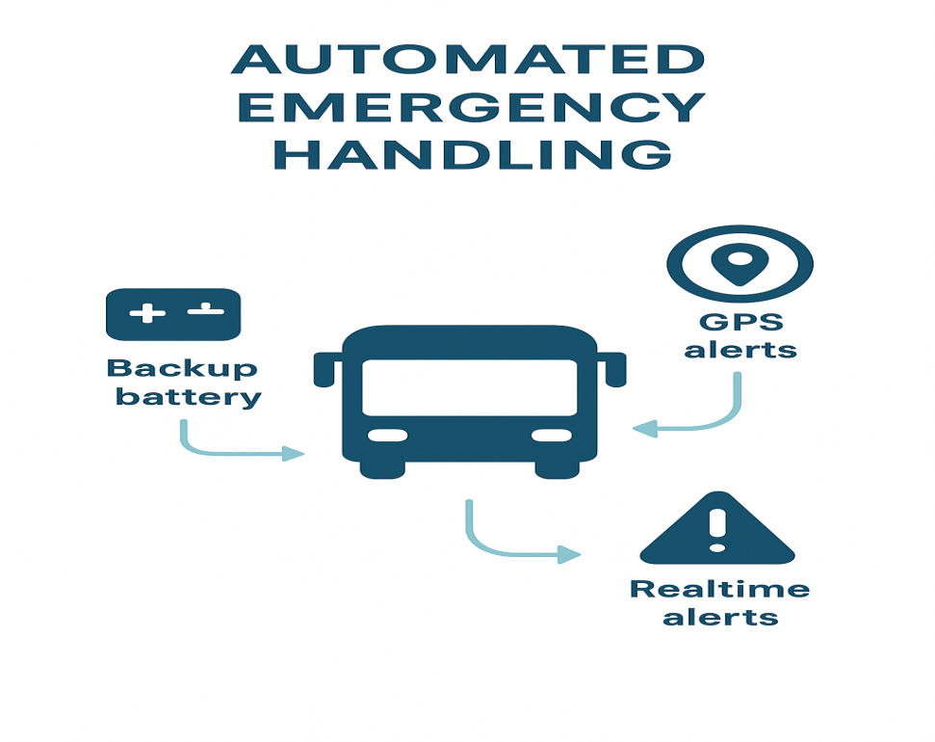
Emergency Handling
The system enables automated emergency handling by rerouting buses, assigning backup battery, and sending real-time alerts via GPS and IoT. It ensures quick response to breakdowns, accidents, or sudden demand surges, maintaining service reliability and passenger safety.

Slide 17
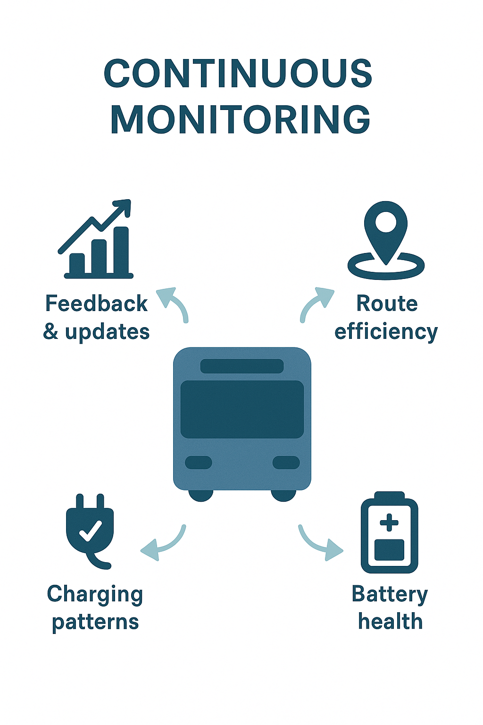
Monitoring & Feedback
The system continuously monitors fleet performance, including bus operations, battery health, charging patterns, and route efficiency. Collected data is analyzed to provide feedback and updates to the optimization algorithms, enabling continuous improvement in scheduling, charging, and emergency response.

Slide 18
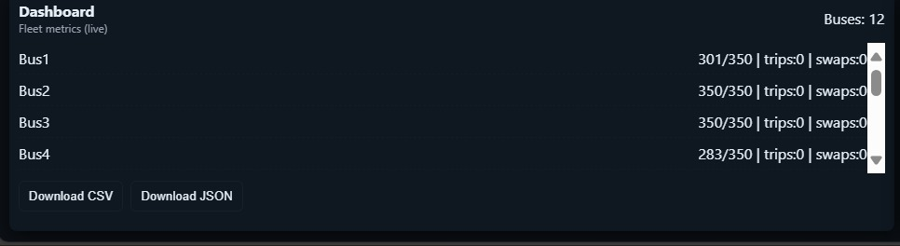
RESULTS

Slide 19
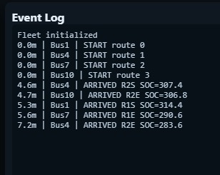

Slide 20
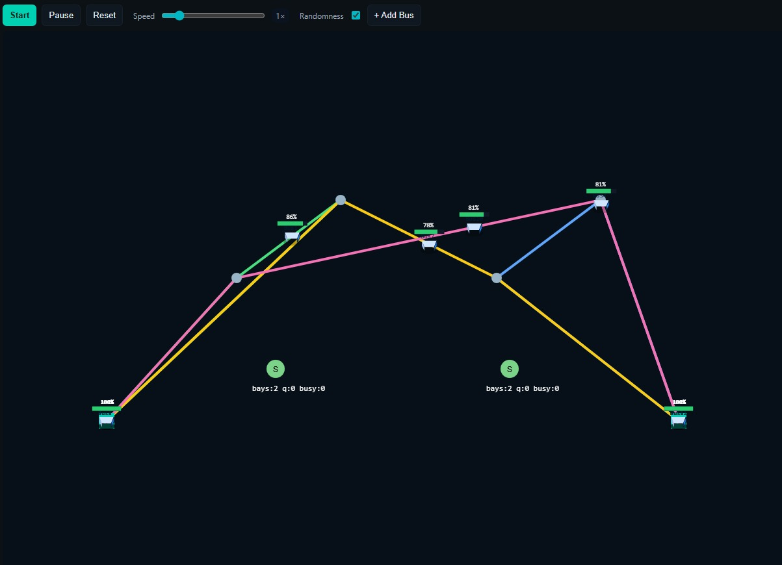

Slide 21
CONCLUSION
The proposed Green Public Transport Network provides an intelligent, data-driven solution for EV bus charging, battery management, scheduling, and emergency handling. By integrating real-time data, AI-based optimization, and renewable energy sources, the system enhances operational efficiency, reduces costs, extends battery life, and ensures reliable service. It also improves passenger safety and sustainability, making it a scalable and effective approach for modern electric public transport networks.

Slide 22
FUTURE ENHANCEMENT
In the future, the system can be enhanced by integrating with smart grids to enable dynamic charging based on real-time grid load and renewable energy availability. Predictive maintenance using AI can monitor battery and bus health to prevent breakdowns, while advanced passenger analytics can improve scheduling and route planning. Additional enhancements include Vehicle-to-Grid (V2G) support, allowing buses to feed energy back to the grid, expanding the system across multiple depots for city-wide scalability, and incorporating autonomous buses to further improve efficiency and safety.

Slide 23
THANK YOU

